Slide 1
The Miracle – and Misery – of Compound Interest

Slide 2
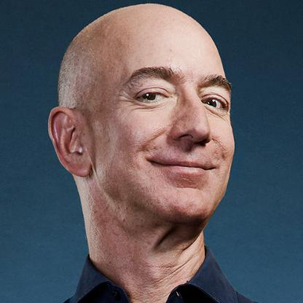
THE RICHEST PEOPLE IN THE WORLD
#1 Jeff Bezos CEO and Founder, Amazon
Net Worth: $115.6 B

Slide 3
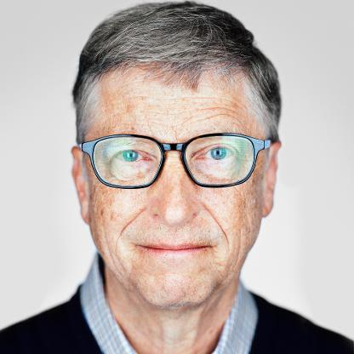
THE RICHEST PEOPLE IN THE WORLD
#2 Bill Gates Co-founder, Bill and Melissa Gates Foundation
Net worth: $110.6 B

Slide 4
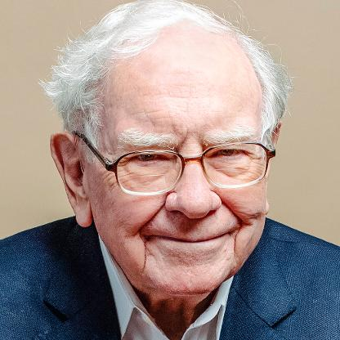
THE RICHEST PEOPLE IN THE WORLD
#3 Warren Buffett, CEO, Berkshire Hathaway
Net worth: $90.6 B

Slide 5
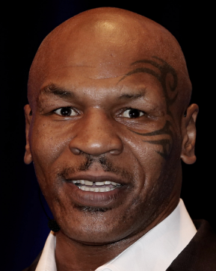
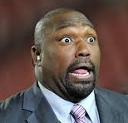
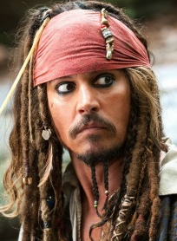
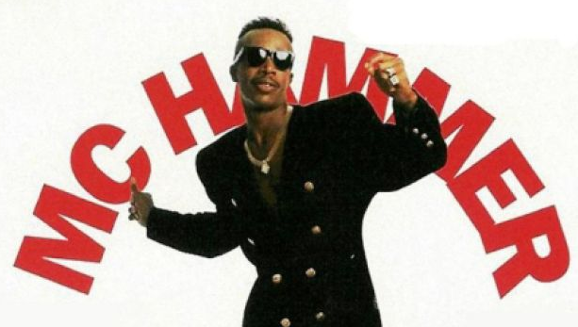
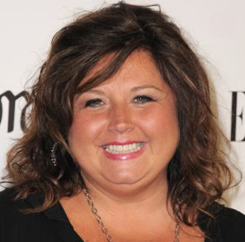
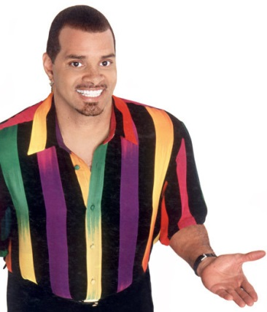
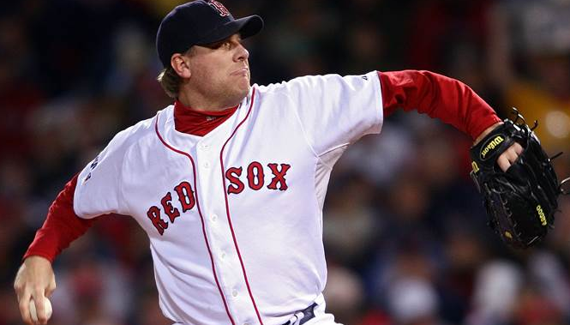
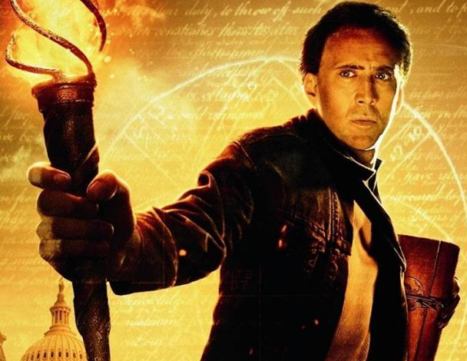
Hall of Shame Celebrities

Slide 6
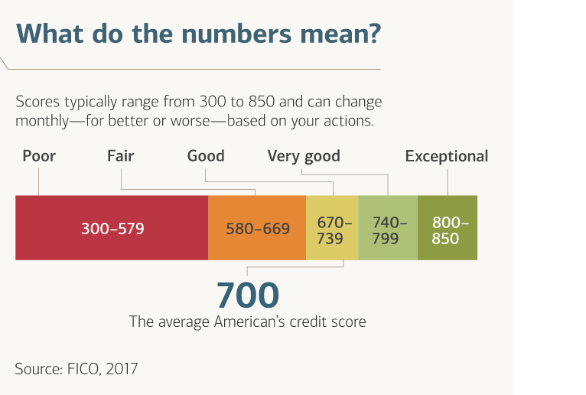
Your Adult Report Card

Slide 7
Estimating Your FICO Score
What goes into a FICO score?

Slide 8
More Money, More Problems?
Not if you learn to handle it
Earn it
Spend it
Save it

Slide 9
What Does this Mean to You?
Meet Miss Be Helpful

Slide 10
Key Ingredients to Wealth Creation
Time
Compounding

Slide 11
Compound Interest
If you were given:
1 penny on day 1;
2 pennies on day 2;
4 pennies on day 3
If you kept doubling over a 31-day month, how much money would you have on day 31?

Slide 12
$10,737,418.24
Day | Amount | Day | Amount
1 | $0.01 | 16 | $327.68
2 | $0.02 | 17 | $655.36
3 | $0.04 | 18 | $1,310.72
4 | $0.08 | 19 | $2,621.44
5 | $0.16 | 20 | $5,242.88
6 | $0.32 | 21 | $10,485.76
7 | $0.64 | 22 | $20,971.52
8 | $1.28 | 23 | $41,943.04
9 | $2.56 | 24 | $83,886.08
10 | $5.12 | 25 | $167,772.16
11 | $10.24 | 26 | $335,544.32
12 | $20.48 | 27 | $671,088.64
13 | $40.96 | 28 | $1,342,177.28
14 | $81.92 | 29 | $2,684,354.56
15 | $163.84 | 30 | $5,368,709.12
 |  | 31 | $10,737,418.24

Slide 13
Compound vs Simple Interest
The big difference explained

Slide 14
Interest Rates
The price of money
Banks pay interest to accountholders
People pay interest to banks, credit card companies, etc. on loans

Slide 15
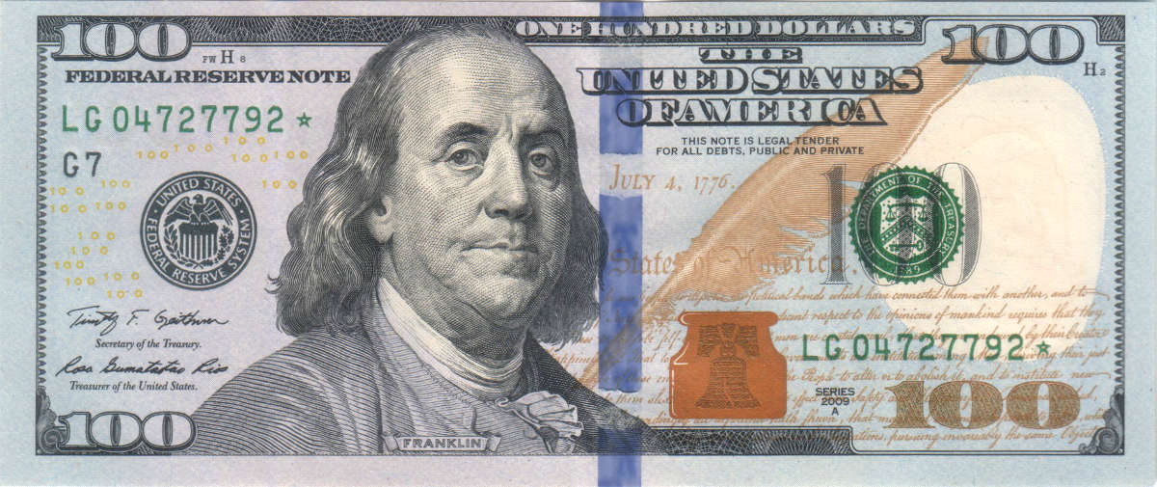
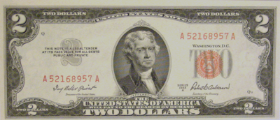
Bank Paying 2%

Slide 16
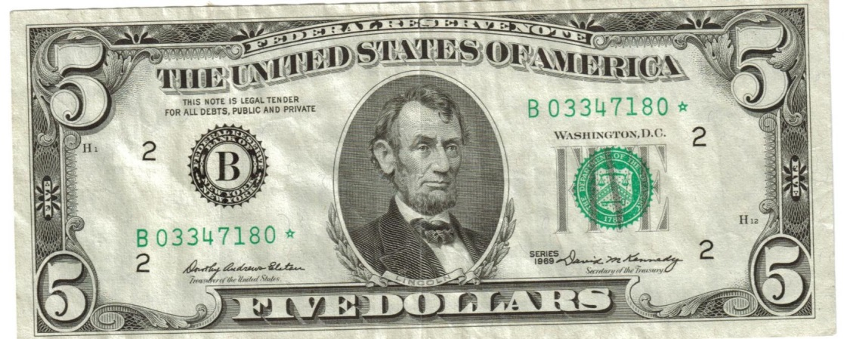
Student Loan Charging 5%

Slide 17
….Borrowing $50,000 For College (6% Interest)

Slide 18
Tips for Controlling Student Loan Debt
Colleges are a business – they want you to attend by whatever means necessary
Some “aid” is really loans
Debt should not exceed your starting annual salary (or monthly payment shouldn’t be more than 10% of take home pay)

Slide 19
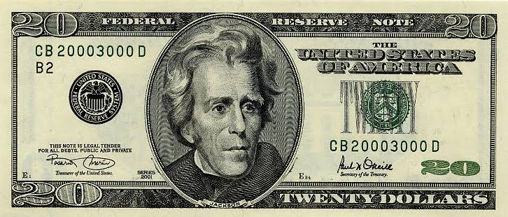
Credit Card Charging 20%

Slide 20
The Cost of Borrowing

Slide 21
Rates and Investments
 | Carlos | Sandra | Olivia
$250 monthly | 0% home/checking | 2% in her savings account | 9% in the stock market
1 yr | $3,000 | $3,060 | $3,144
5 yrs | $15,000 | $15,924 | $18,818
10 yrs | $30,000 | $33,506 | $47,771
20 yrs | $60,000 | $74,350 | $160,864
40 yrs | $120,000 | $184,830 | $1,062,412

Slide 22
Investing

Slide 23
Why Save, Why Invest?
We save for short-term goals and to keep the money safe (it won’t go down in value).
Invest to grow our money to meet future expenses, such as college costs or retirement.
We invest to outpace inflation. Saving does not outpace inflation.

Slide 24
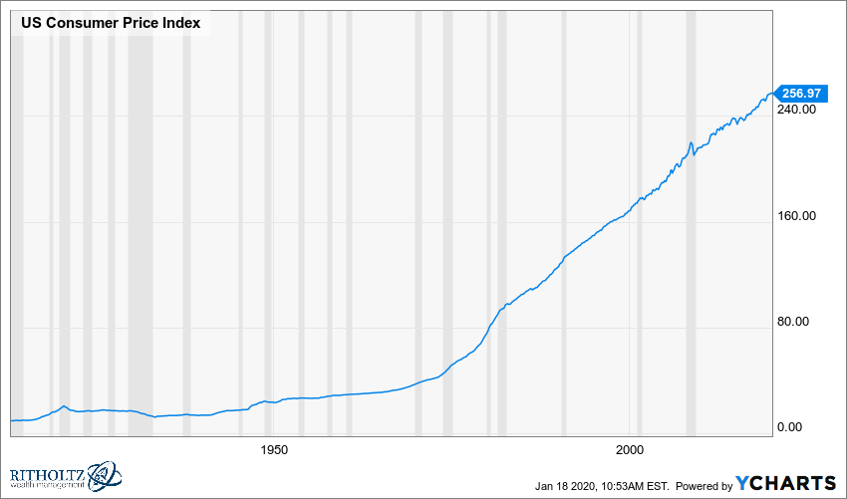
Declining Purchasing Power

Slide 25
What’s the Real Cost?
Today’s dollars matter

Slide 26
Compound Interest
If you were given:
1 penny on day 1;
2 pennies on day 2;
4 pennies on day 3
If you kept doubling over a 31-day month, how much money would you have on day 31?

Slide 27
$10,737,418.24
Day | Amount | Day | Amount
1 | $0.01 | 16 | $327.68
2 | $0.02 | 17 | $655.36
3 | $0.04 | 18 | $1,310.72
4 | $0.08 | 19 | $2,621.44
5 | $0.16 | 20 | $5,242.88
6 | $0.32 | 21 | $10,485.76
7 | $0.64 | 22 | $20,971.52
8 | $1.28 | 23 | $41,943.04
9 | $2.56 | 24 | $83,886.08
10 | $5.12 | 25 | $167,772.16
11 | $10.24 | 26 | $335,544.32
12 | $20.48 | 27 | $671,088.64
13 | $40.96 | 28 | $1,342,177.28
14 | $81.92 | 29 | $2,684,354.56
15 | $163.84 | 30 | $5,368,709.12
 |  | 31 | $10,737,418.24

Slide 28
An Easy Way to Get $1 Million
Invest $100
Add $200/month for 50 years earning 7%

Slide 29
The Market For Air Jordans

Slide 30
Just Do It

Slide 31
Can You Choose Just One?
Why Would You Do That, When You Can Own Them All?

Slide 32
The Benefits of Owning the Index
Diversification – to reduce risk

Slide 33
The Benefits of Owning the Index
Diversification – to reduce risk
Cost – low investment costs are good for returns

Slide 34
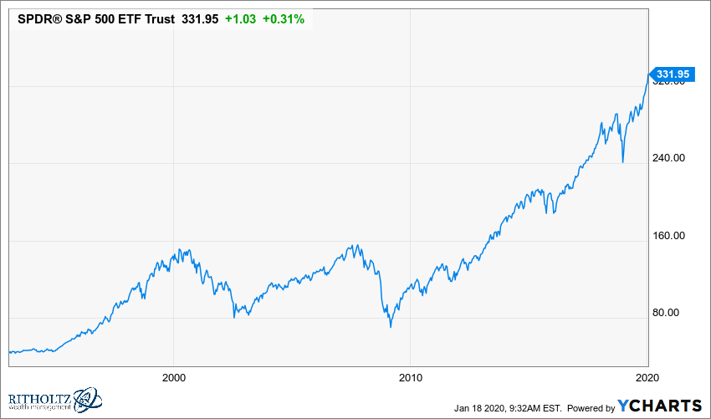
SPY

Slide 35
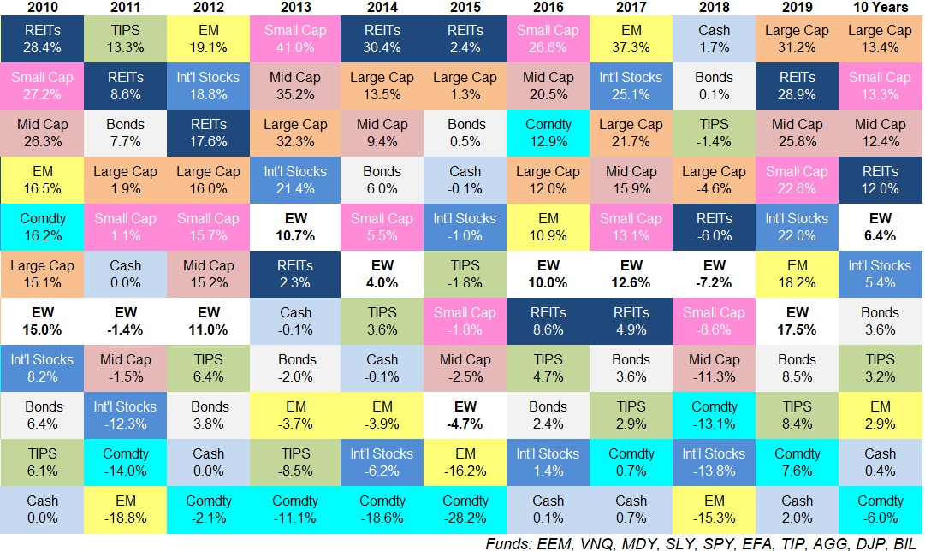
It’s Impossible to Predict the Winners

Slide 36
Warren’s Wisdom

Slide 37
Warren’s Wisdom

Slide 38
Your Biggest Asset is Time
Warren Buffet started investing at age 11 from paper-route money.
He was smart enough to EARN money and INVEST it at an early age.
He is worth $81 billion, but if he started investing at age 22 instead of 10, he would be worth $1.9 billion instead.
Source: Morgan Housel, “The Freakishly Strong Base,” 10/31/2017

Slide 39
It’s Not How Much You Earn…. It’s How Much You Save

Slide 40
Rates and Investments
 | Carlos | Sandra | Olivia
$250 monthly | 0% home/checking | 2% in her savings account | 9% in the stock market
1 yr | $3,000 | $3,060 | $3,144
5 yrs | $15,000 | $15,924 | $18,818
10 yrs | $30,000 | $33,506 | $47,771
20 yrs | $60,000 | $74,350 | $160,864
40 yrs | $120,000 | $184,830 | $1,062,412

